Slide 1

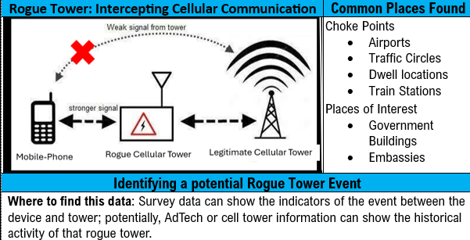
Master Dashboards Template: Cellular DFP
Uses Network Survey (NS) data to shape understanding of cellular activity in AOI
Detects anomalies in cellular behavior (service drops, missing neighbors, abnormal signal strength, unexpected carrier codes) that may signal threats.
Provides situational awareness to deter adversary use of manipulated or abnormal cellular infrastructure.
Enables analysts to filter, pivot quickly, and map data by time, location, or device.
Supports decision-making and deterrence with clear visualizations (heat maps, histograms, line charts).
Threat Detection | Operations and Planning
Capture signatures associated with Rogue Towers | Identify areas with less secure technologies (2G GSM & 3G UMTS)
Jamming – Signals are blocked, causing sudden loss of service in an area. | Mapping of the cellular environment
 | Cellular change detection
Capture signatures of Cross-Border Signal Expansion | Monitor blue force digital footprint

Slide 2

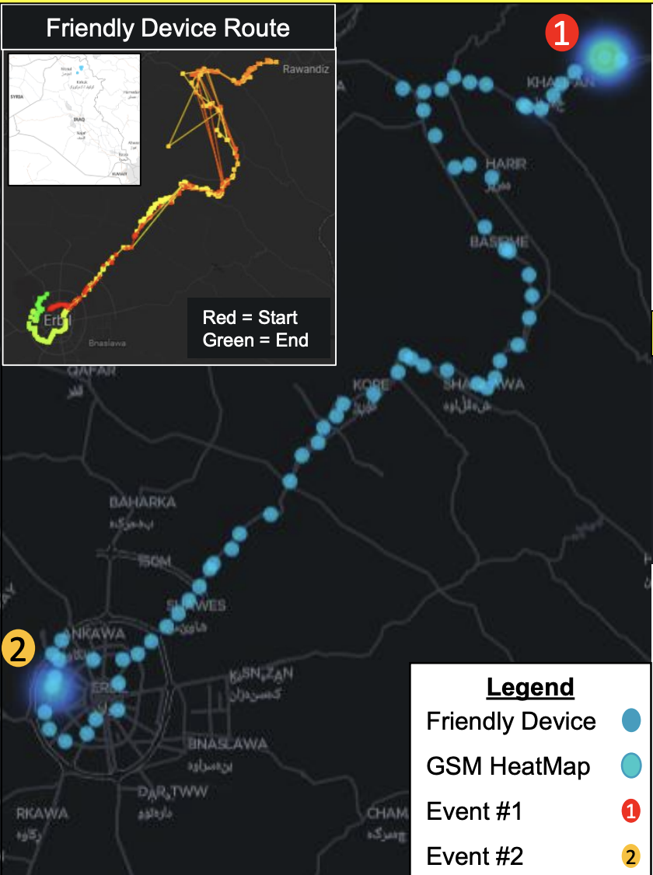
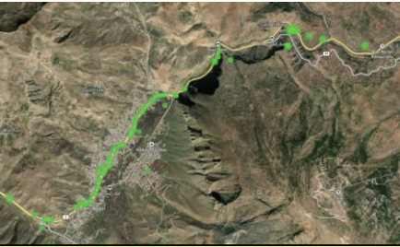
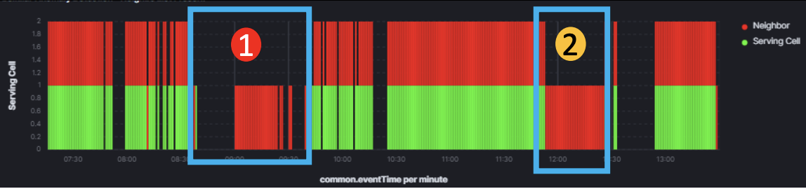
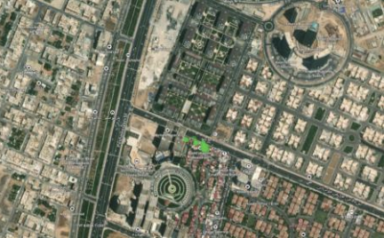
Cellular DFP Dashboard used for- Ebril Iraq
BLUF: ShadowView visualized Cellular data records for Digital Force Protection (DFP) overwatch leading to the identification of two cellular anomalies that occurred during a routine route on 04JAN24 from 0700Z – 1330Z.
Details
Event 1
Details
EUD streaming NS data to the data lake (WiFi, Bluetooth, Cellular & GNSS records)
The analysis was conducted after the route due to having little to no digital baseline.
2 events shared unexpected drops in service from LTE to GSM.
Each Anomaly meet specific criteria to be considered anomalous.
Event 1 has met the threshold to be considered a significant Cellular Anomaly
Event 2: identified that their was a pattern of anomalies
Results were relayed to operators back on the ground to take mitigating actions
Where: Valley Terrain
Severity 4 Alert
5/9 cellular signature anomalies met
-Time&Length: 40Min 0900Z– 0940Z
Record count Increased
Drop in Technology 4G to 2G
Valley ideal for digital choke point
Potential Natural Interference
Alert Dashboard for Cellular Neighbor Lists
Event 2
Details: 2 hours later
Where: Urban Terrain
Severity 2 Alert
3/ 9 Cellular anomaly Signatures met
Time &Length: 32Min 1153Z – 1225Z
Record count Increased
EUD was stationary in building in Urban Terrain
2nd Event starts a pattern of anomalies
Notes:
Progression of isolated events into a pattern to "Initially, a cellular anomaly was detected at one location. Then, 30 minutes later, another anomaly occurred in a different location. At this point, a pattern starts to emerge, prompting a shift in analysis. Viewing it through a new lens, a co-traveler alert is triggered, revealing that access points (APs) have been following along the path—another anomaly. From there, these anomalies are cross-referenced against AdTech data to identify and build intelligence on the devices consistently appearing in proximity, strengthening the case for potential surveillance or targeting."
Spotting Digital Threats Like a Broken Leg
Detecting cellular anomalies is like diagnosing a broken leg—no single symptom gives the full picture. Just as a doctor checks for swelling, bruising, and difficulty walking, Digital Force Protection (DFP) analytics look at multiple signs before flagging a potential threat.
Case Study: Cellular Anomalies in Erbil, Iraq
On 04JAN2024, a device used by an end user (EUD) scanned the area in Erbil, Iraq, collecting data on Wi-Fi, Bluetooth, Cellular, and GNSS networks. This data was processed through the analytic system, which alerted the DFP team to two unusual events—potential signs of hostile activity.
Event 1: Major Cellular Anomaly (0900Z – 0940Z) The analytic flagged this event as a major threat based on several warning signs:
Drop from LTE (4G) to GSM (2G): A tactic used to force devices onto a less secure network.
Only one nearby tower detected: Makes it hard for devices to switch to a legitimate network.
Loss of neighboring towers: Suggests control over the network.
Unusual signal spike: Could be from an unauthorized tower.
New, unknown tower detected: Indicates an unregistered access point.
The analytic pulled these multiple symptoms together and alerted the team that this pattern likely pointed to a rogue cell tower or IMSI catcher, which could track movements, intercept communications, and disrupt networks.
Event 2: Natural Interference vs. Real Threat A second anomaly was detected, but it didn’t meet the severity threshold of the first event. Just like swelling alone might not confirm a fracture, interference from buildings or terrain could be mistaken for a real threat. The analytic helps by comparing this data against historical records to confirm whether it’s a legitimate anomaly.
Why This Matters for DFP & Active Forces A rogue tower can:
Track friendly forces.
Intercept communications.
Force devices onto an adversary’s network.
Disrupt communications in critical areas.
By identifying these threats early, DFP teams can act quickly to protect forces.
Next Steps: Digging Deeper Once the analytic flags an anomaly, the next step is to investigate:
Co-Traveler Analysis: Identify devices that were moving with friendly forces.
AdTech Data Cross-Check: Check if devices connected to the rogue tower.
Pattern of Life Analysis: See if devices had been in the area before.
Turning Data into Action The analytic system works in the background, pulling data from network surveys (Wi-Fi, Bluetooth, Cellular, GNSS), running it through ShadowView and Kibana, and flagging threats. This allows DFP teams to quickly respond and prevent adversaries from exploiting vulnerabilities. Just like diagnosing a broken leg, it’s about recognizing all the symptoms to stop a bigger problem before it happens.

Slide 3
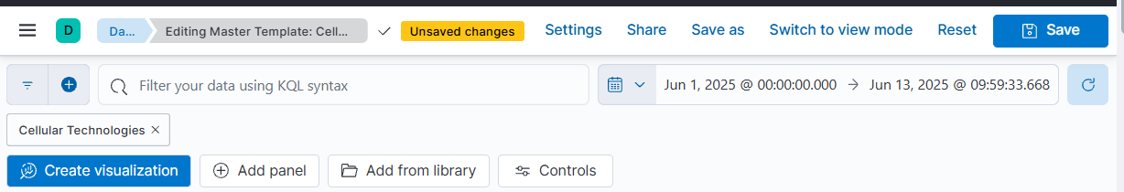
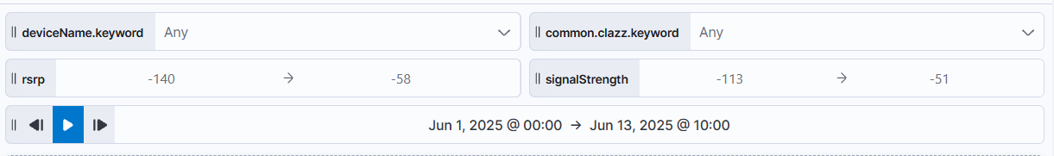
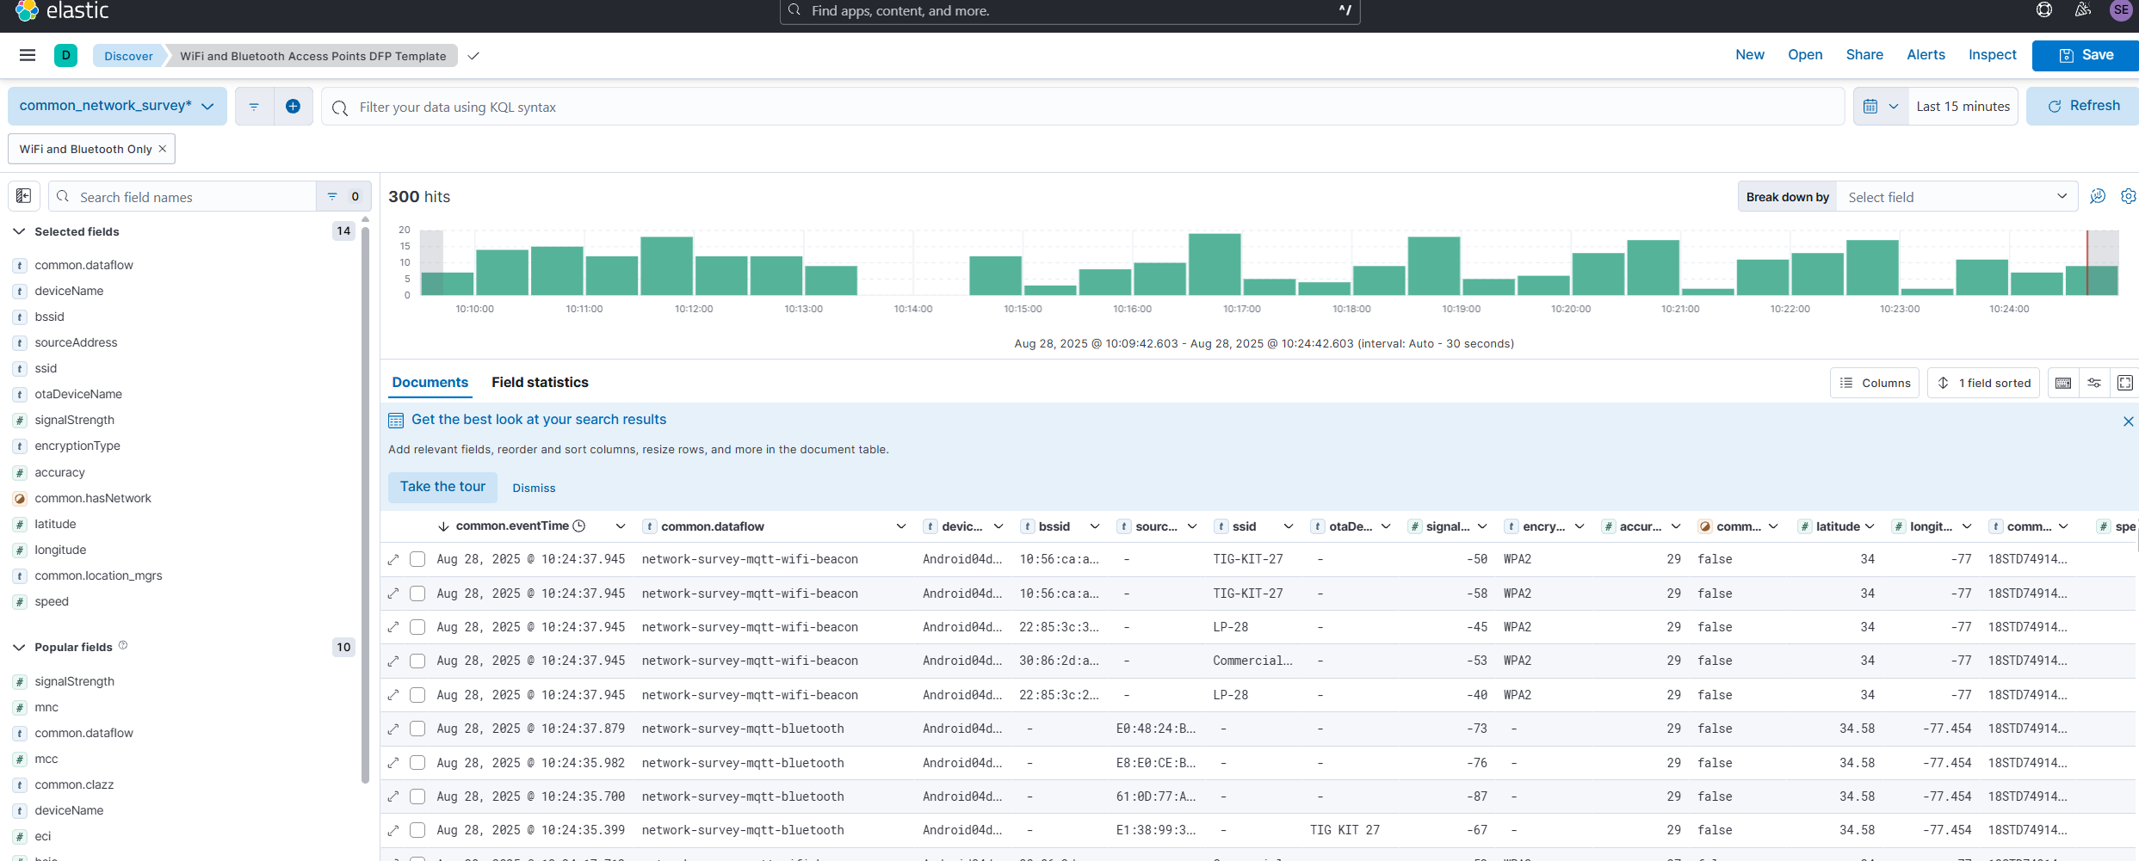
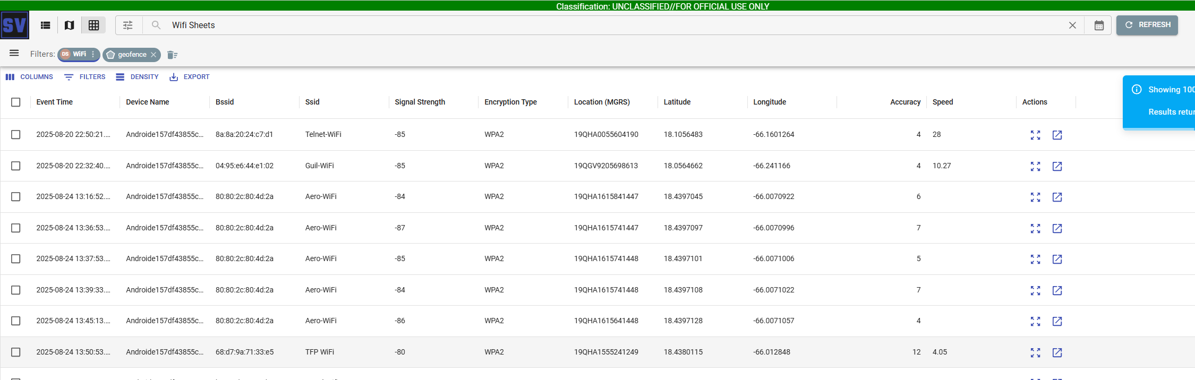
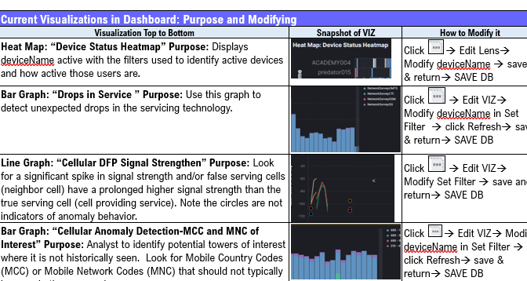
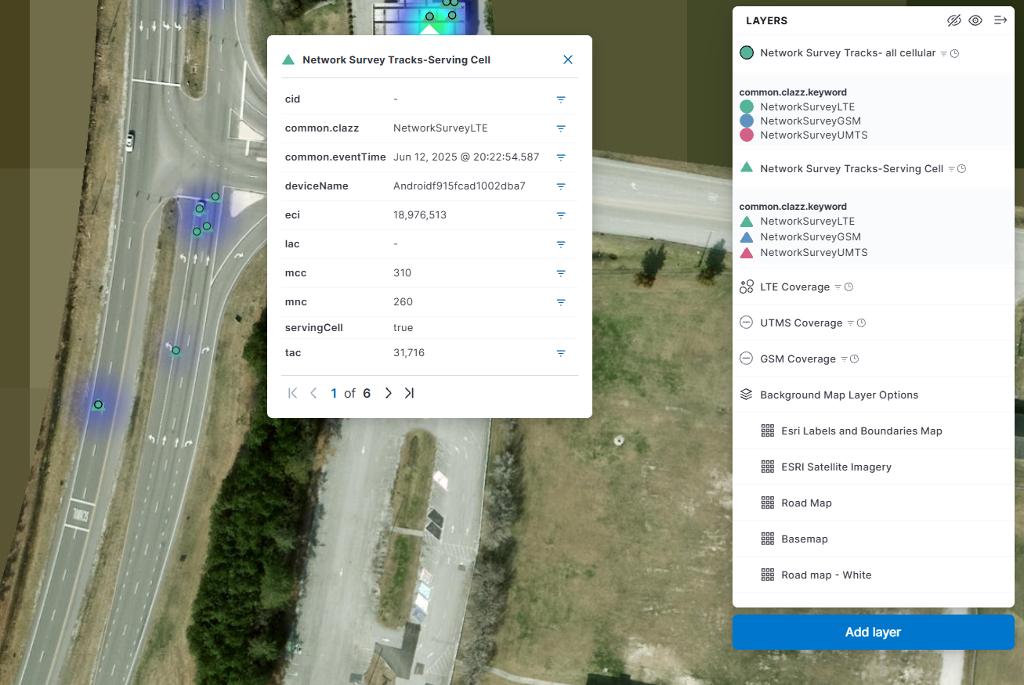
Master Dashboards Template: Cellular DFP
Dashboard Functions
Dashboard Functions
Starting point for filtering data in the Master Template
Analysts can query by device, set time ranges, and begin shaping results
Template can be cloned, shared, and modified for specific analysis intent
Controls
Controls
Interactive filters for refining results in the Master Template
Narrow data by clazz (2g,3g,4g), device name, DTG range , & signal strength GSM and UMTS (LTE RSRP)
Filter for specific devices or access points for deeper analysis
Pivot Data
Pivot Data
Provides pivot URLs with predefined field maps in both SVIEW cellular fields all technologies and Kibana (Sheets View & Discover)
Enables data exploration without rebuilding filters or re-selecting fields
Includes a Dashboard Handbook link explaining how to modify visualizations and explain DFP purpose.
Maps
Maps:
Map 1 –Identifies the end users cellular technologies as well as a heat map of those technologies and than identifies the serving cell vs the neighboring cell.

Slide 4
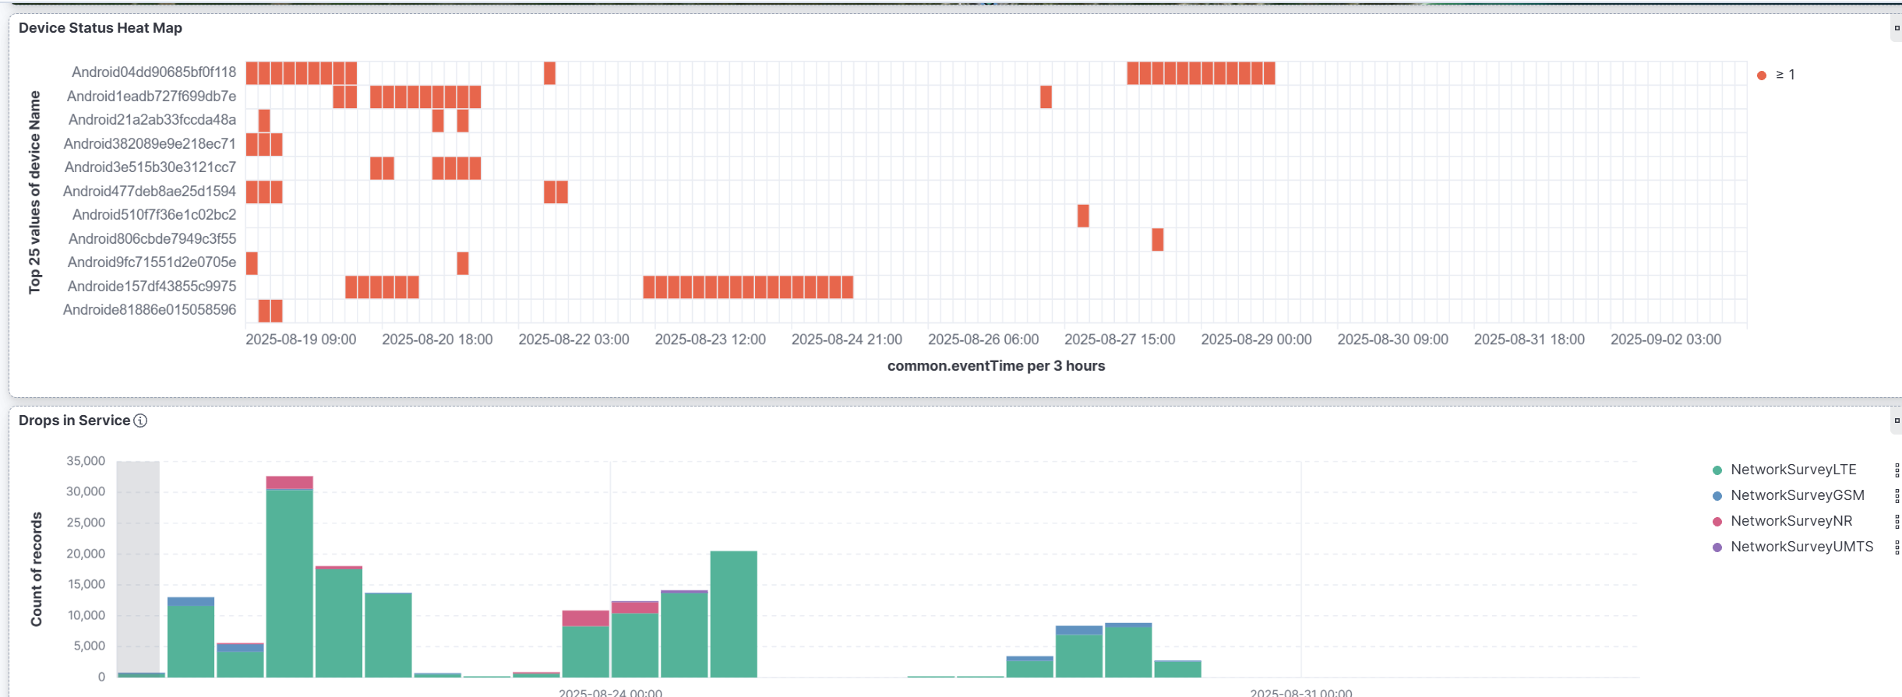
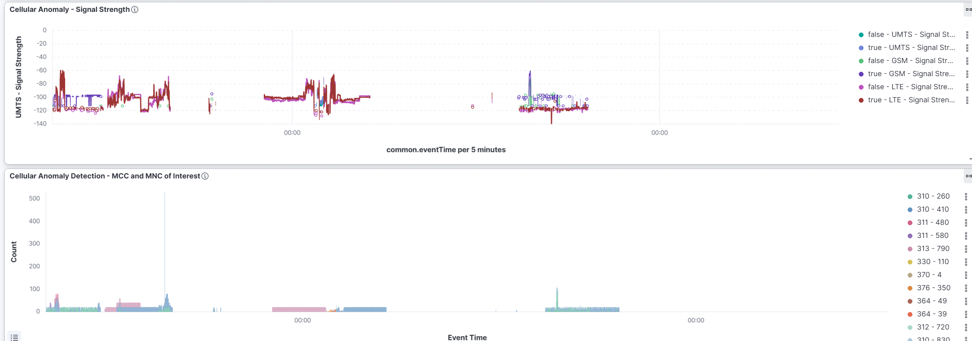
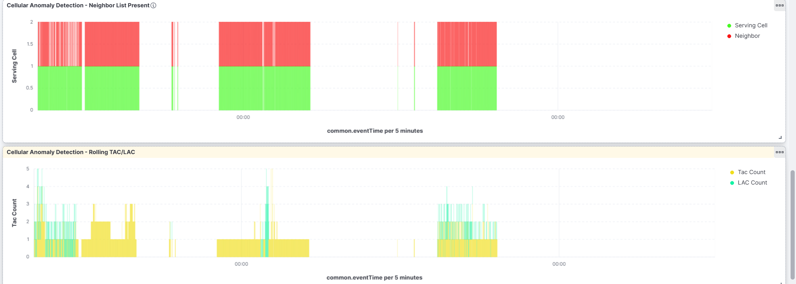
Master Dashboards Template: Cellular DFP
Device Status Graphs
Device Status Graphs- current end users- deviceNames activity
Device Heat Map: Displays criteria filtered end users in the dashboard, great tool for operations pre-check devices are operational.
Devices in AOI Metric Display – Shows the total number of end users
Service Drop Detection Histogram–IDs gaps in records or service that may indicate anomalies
Cellular Tower Measurements
Cellular Tower Measurements – Used to ID anomalous cell tower activity
Neighbor List Histogram) – Shows serving vs. neighbor cells; normally equal (red/green), anomalies if only red or green.
Signal Strength Line Chart – Compares serving cell vs. neighbor cell; serving cell should usually be stronger.
Rolling TAC/LAC Chart – Detects anomalies when rapidly changing
MCC/MNC Histogram – Identifies country and carrier codes; only the expected MCC (country code) should appear.

